Slide 1
Unix Project Thing
Print screens of what happened

Slide 2
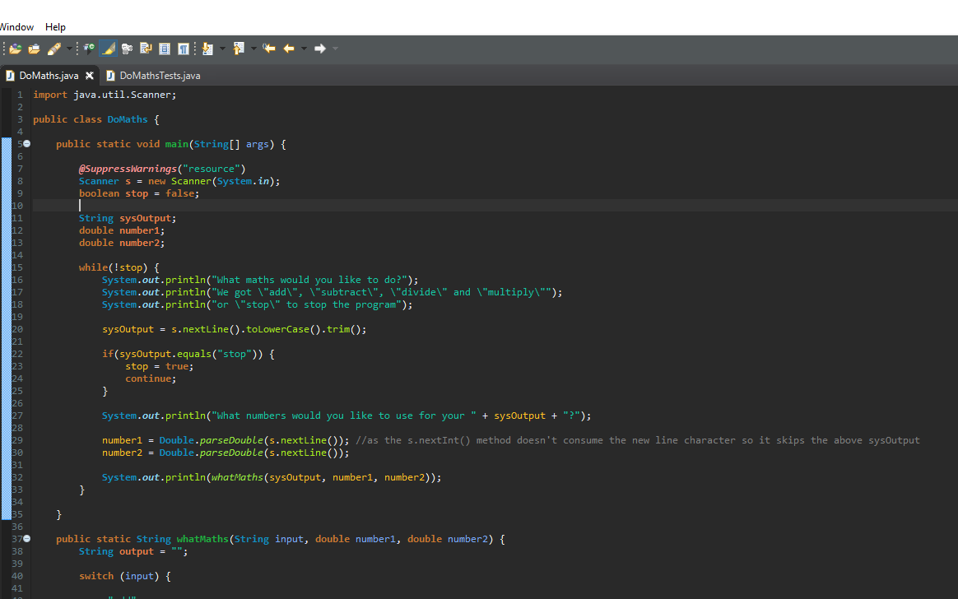
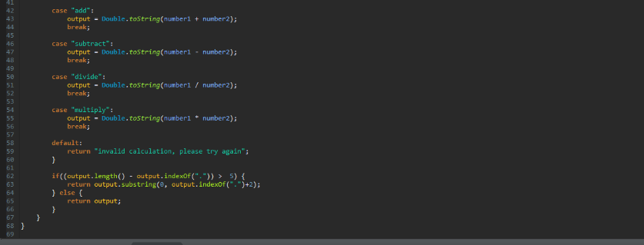
Working code for the calculator

Slide 3
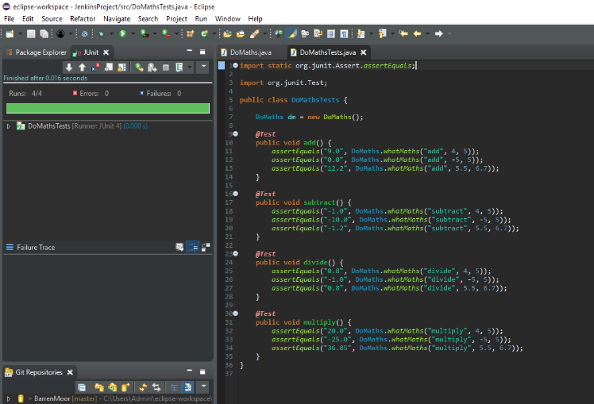
Working code for test suit for calculator

Slide 4
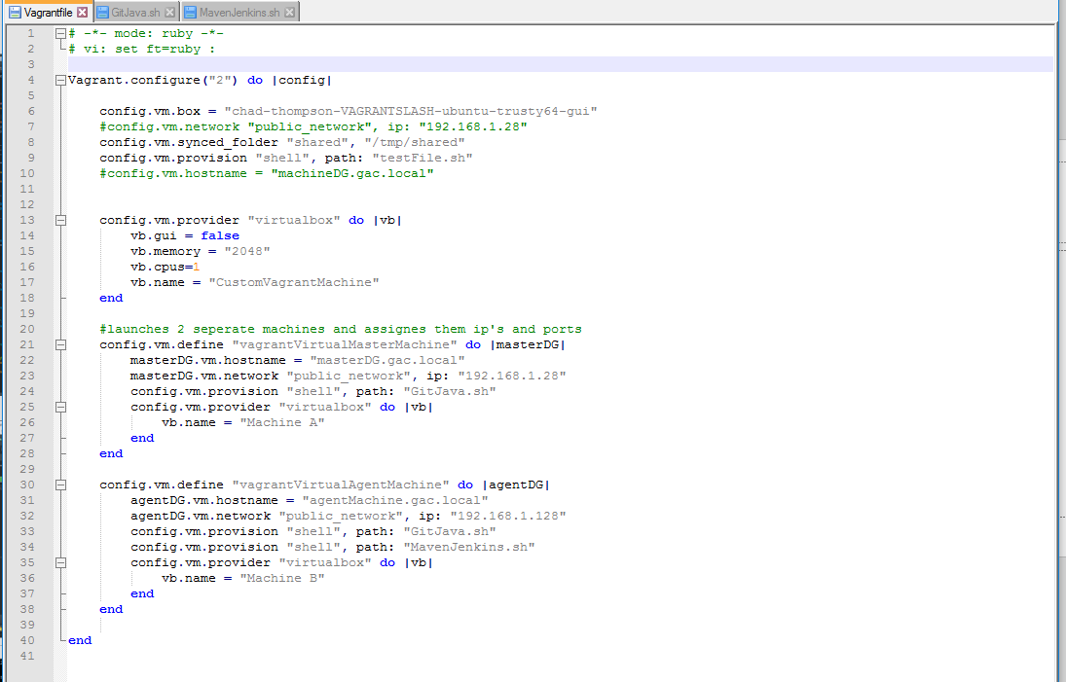
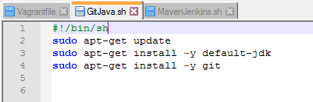
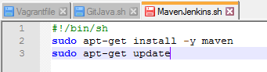
Vagrant setup files and installs for VM’s

Slide 5
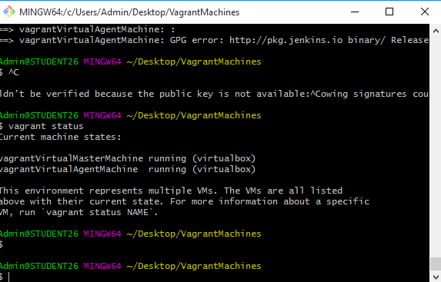
Creating the vagrant machines in bash

Slide 6
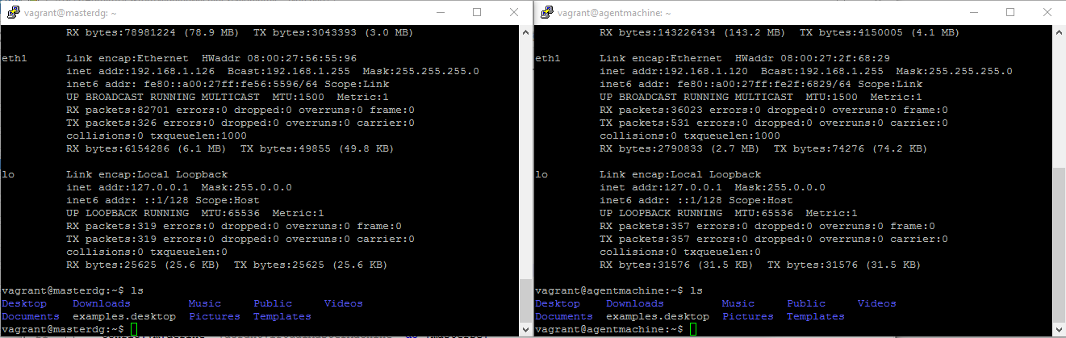
SSH’d into the vagrant machines

Slide 7
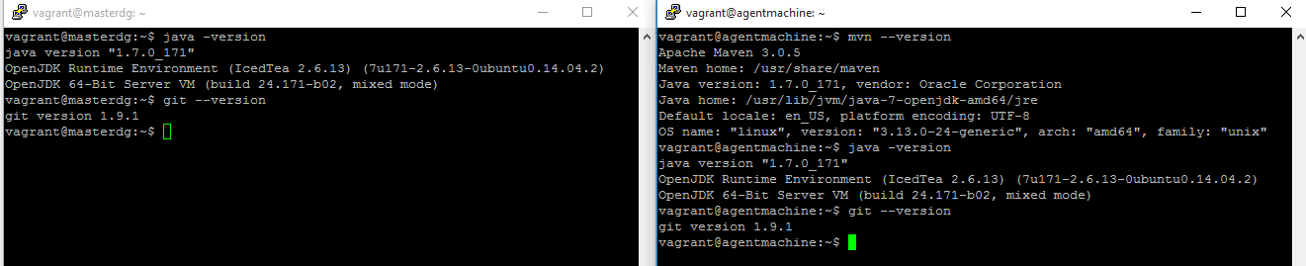
Checking that Java, Git and Maven are installed

Slide 8
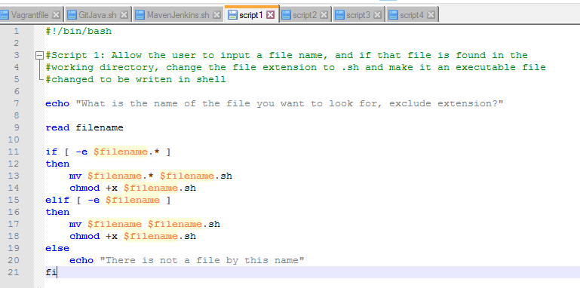
Script 1

Slide 9
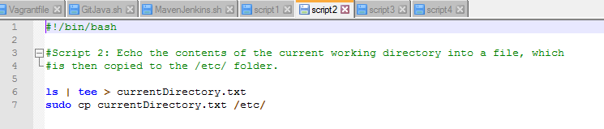
Script 2

Slide 10
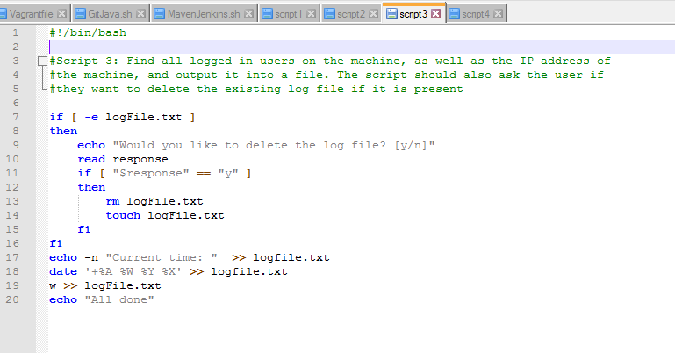
Script 3

Slide 11
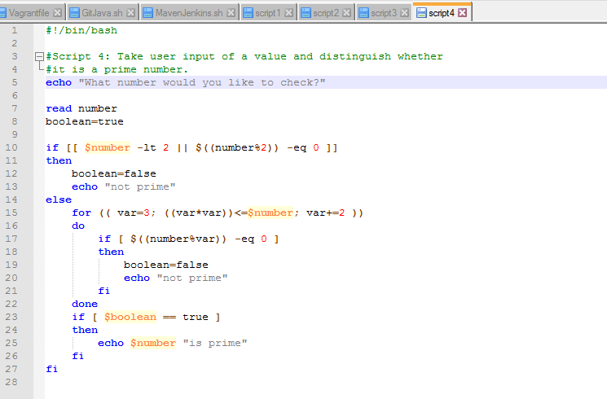
Script 4

Slide 12
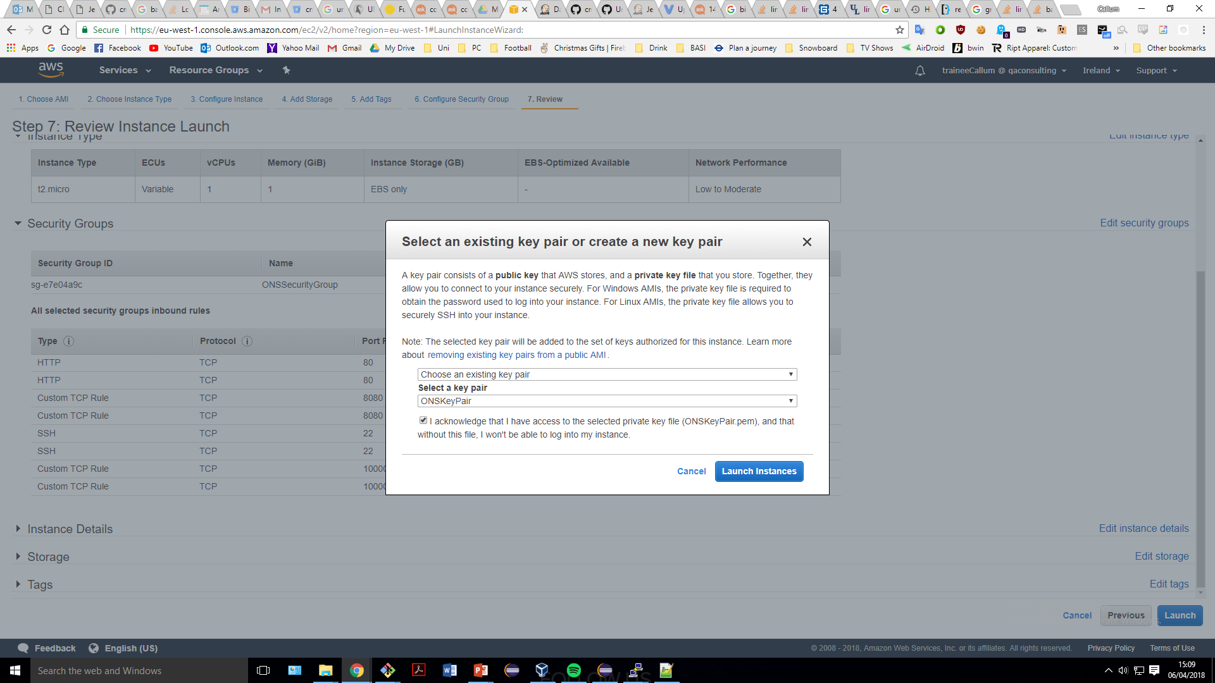
Creating the AWS machine

Slide 13
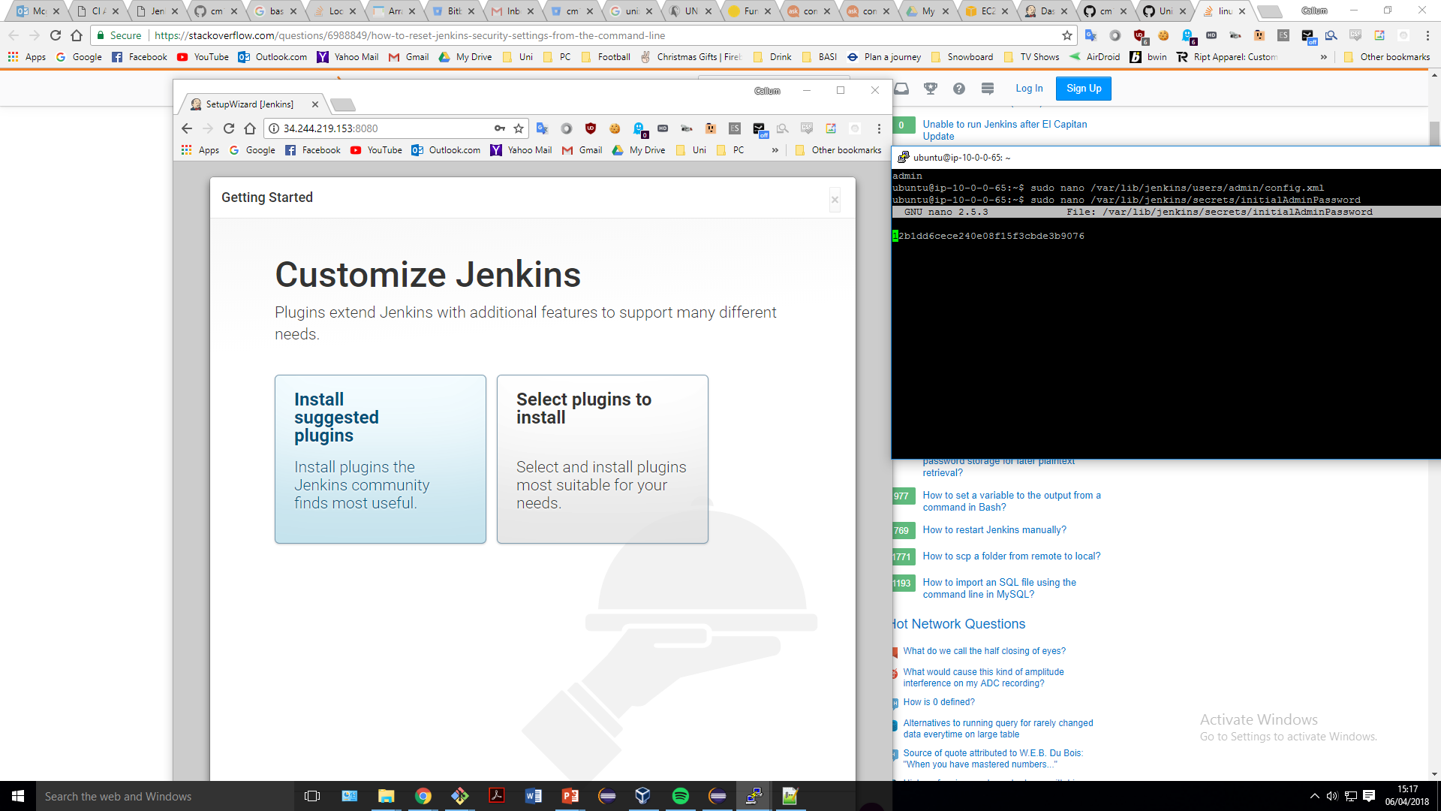
Logging into Jenkins using the admin password

Slide 14
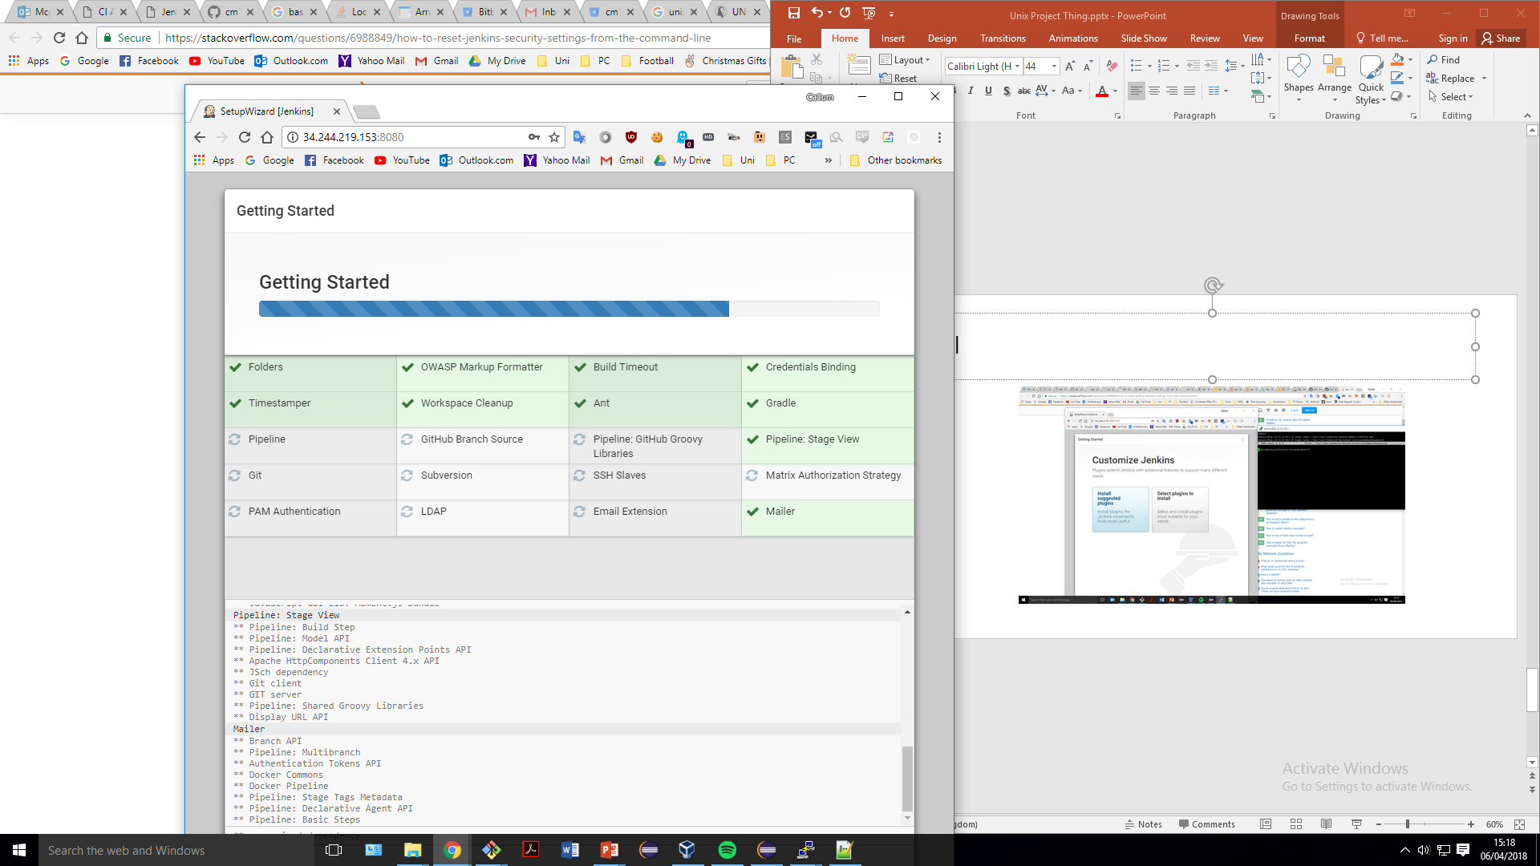
Installing all the plugins

Slide 15
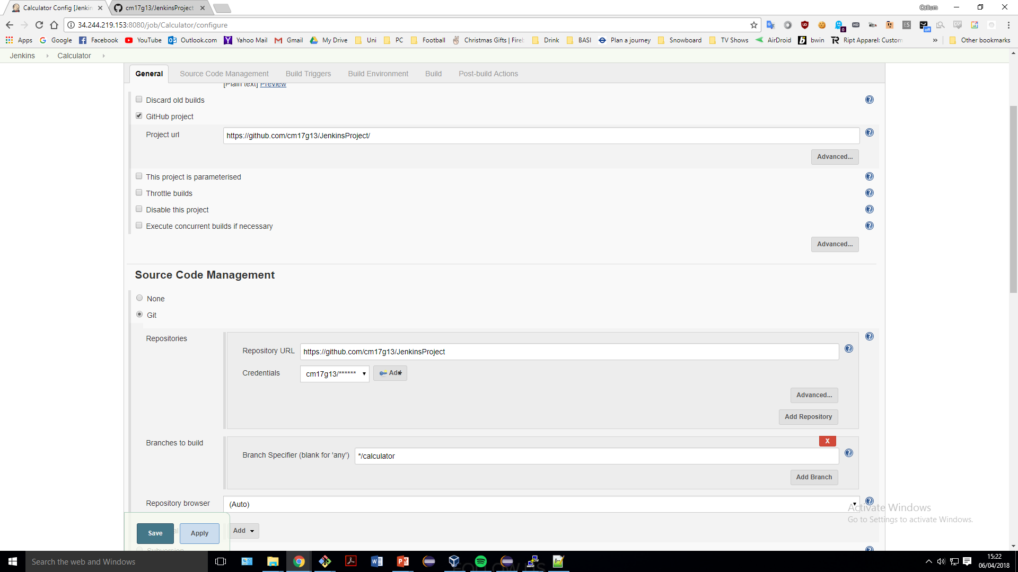
Creating the project

Slide 16
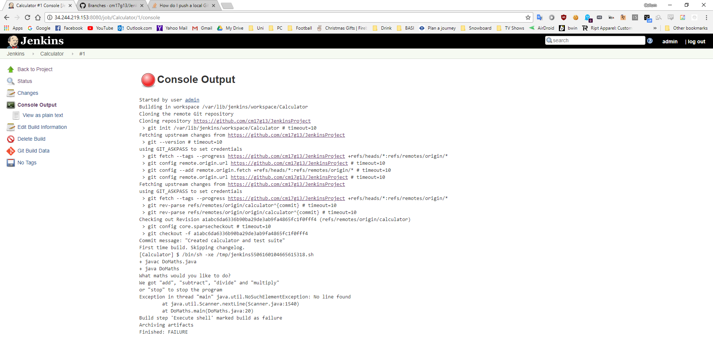
Jenkins project failing from no user input

